Slide 1
FinTech Project 3
Real Estate Title Transfers and Registration
Mayura Solow
Nico Eiden
Dan Watson

Slide 2
The Why…..
Buying and selling a home has, for the most part, been been stuck in the same antiquated processes.
The title insurance industry is a 7 Billion a year industry that is build on the idea that errors are inevitable based on the way things are currently done.

Slide 3
Business Rules
Only the City can issue a new Title
The title will have information such as Tax ID, Buyer, Seller, Bank, Lien Amount, and URI for metadata
Display Home Title functionality can be executed by any address
Lien can only be executed by the City
The transfer of the Title can be carried out by the Owner or the City

Slide 4
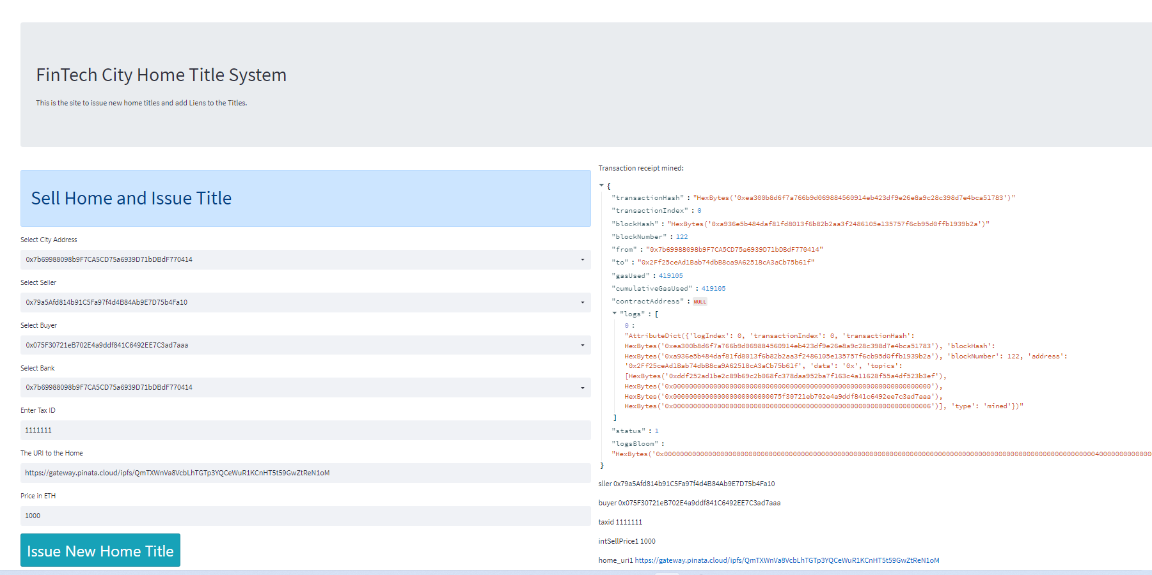
Tokenize Real Estate Titles

Slide 5
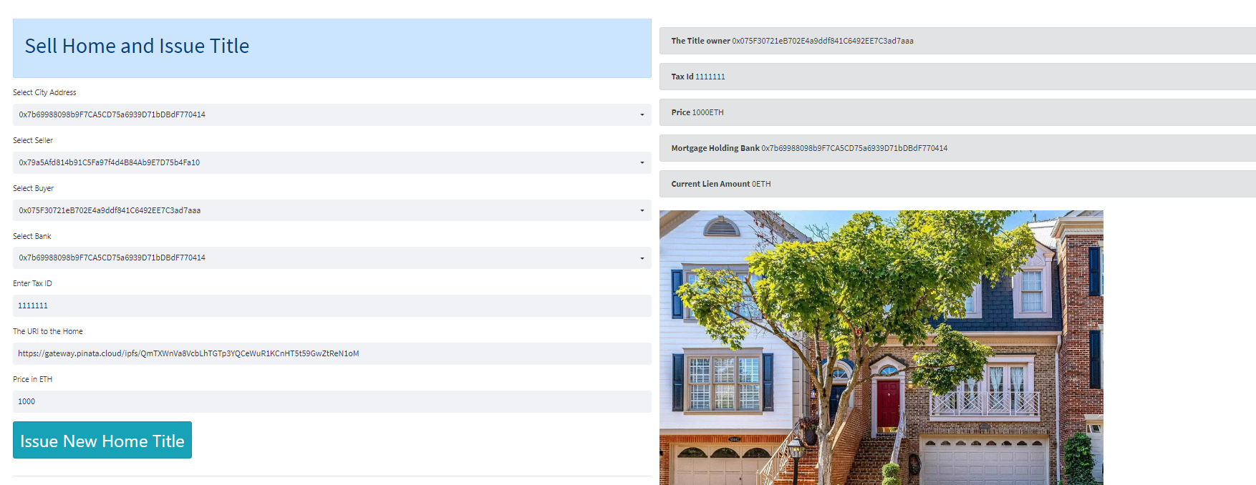
“The New Deed”

Slide 6
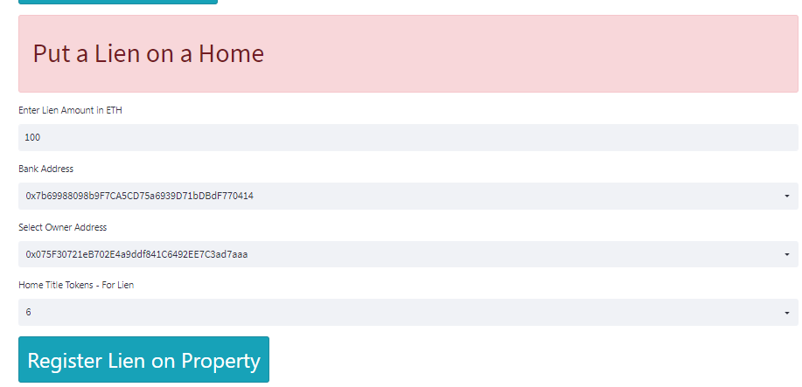
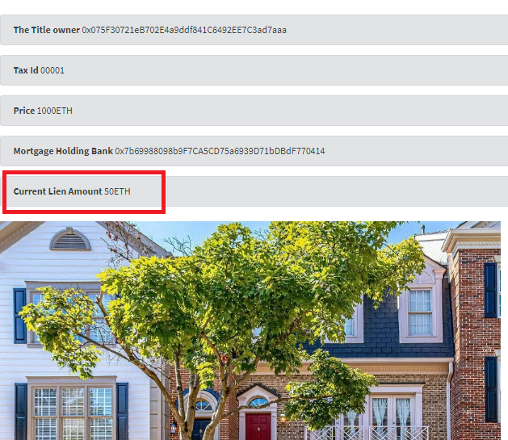
Mortgages and other Liens..

Slide 7
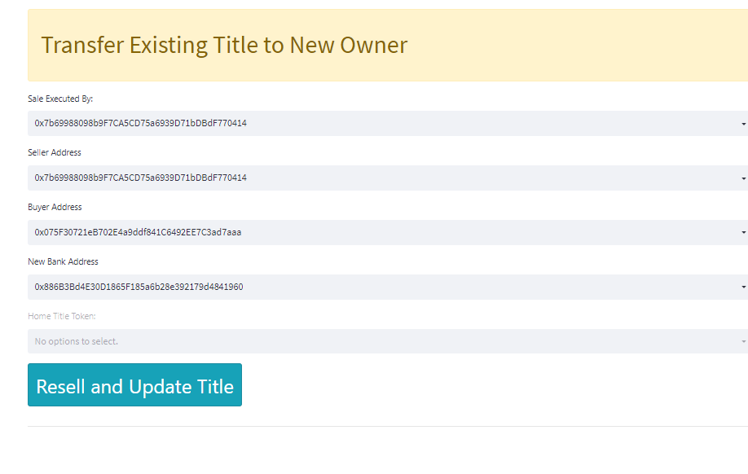
Transfer of Existing Title to New Owner

Slide 8
Conclusion
This will be a viable future for the real-estate industry.
This structure can work for other industries where “title” is transferred from person to person (vehicle sales, art, etc..).
Possible issues.
Re-educating/revamp entire industries.
Logistics and cost for smaller markets.

